Slide 1
Getting the Hang of PyCharm: Tutorial + Lab
By Doug Purcell

Slide 2
How to download these presentations?
Don’t you HATE it when you can’t download the slides to a cool tech presentation??? I do too! Below are several ways that you can download the Getting the Hang of PyCharm slides
1. GitHub ⇒ http://bit.ly/2RSS6YM
2. Google Slides ⇒ http://bit.ly/2qNtq8j
3. Purcell Consult (my site) ⇒ http://bit.ly/2OKZROr

Slide 3

Brief PyCharm Background
Popular cross platform feature-rich IDE that allows coders to develop Python, Django, Flask, R, and Pyramid apps.
Developed by the Czech company JetBrains which creates a suite of IDES such as IntelliJ, WebStorm, PhpStorm, and RubyMine
PyCharm comes in three editions: community, educational, and professional. The first two are open source projects while the latter is commercial and contains more features like Python web frameworks integration and database programming.
This tutorial uses PyCharm community edition

Slide 4
Why PyCharm as opposed to the gazillions of Python IDEs and Editors?
There are no shortage of quality IDEs and editors for building Python programs.
Wing, Spyder, Ninja-IDE, Komodo Edit, Sublime, Atom, Aptana, Eclipse, Visual Studio, and NetBeans.
This tutorial targets PyCharm because it’s more mainstream.

Slide 5
What Can You Do With PyCharm?
A whole lot. Let’s analyze the features.

Slide 6
A Highlight of the Core Features of PyCharm
Intelligent code editor
Smart code navigation
Fast and Safe Refactorings
Documentation
Multi Language support
A powerful debugger
Version control support
Bash language support
Support for bug tracking systems
Scientific and Data Science support
Customizable

Slide 7
PyCharm Professional
Python web frameworks support (Django, Flask, Google App Engine, Pyramid, and web2py)
Database tools (Oracle, SQL Server, PostgreSQL, MySQL)
Support for remote development (deploy & debug code on remote servers, virtual machines, and Docker containers)

Slide 8
How to Install PyCharm
First, meet the suggested software/hardware requirements
4 GB RAM, 8 GB recommended
1.5 GB hard disk space with at least 1 GB for caches
1024×768 minimum screen resolution
Python 2, versions 2.6 & 2.7, or Python 3 versions 3.4 up — 3.7

Slide 9
Install Python
If you don’t have Python installed then you can check out this tutorial to learn how to install Python.

Slide 10
Installing PyCharm on Windows
Download the appropriate version of PyCharm for your operating system.
If you’re operating on a Windows machine simply find the executable file and run it; it should look something like PyCharm-*.exe.
Follow the instructions of the installation wizard.

Slide 11
Installing PyCharm on MacOS
Open the PyCharm-*.dmg package and drag PyCharm to the applications folder.

Slide 12
Linux(Ubuntu/Debian)
If you’re running Ubuntu 16.04 or higher then you can use snap packages to install Python. You can do this by running the following command:
sudo snap install <pycharm-professional,·pycharm-community, or·pycharm-educational> --classic
Then, run pycharm-professional, pycharm-community, or pycharm-educational in the Terminal. If snap is not available then...

Slide 13
PyCharm Linux Installation Cont
a) Copy pycharm-*.tar.gz to an empty directory. Make sure the directory has rw permissions.
b) Unpack pycharm-*.tar.gz using the following command: tar xfz pycharm-*.tar.gz.
c) Remove pycharm-*.tar.gz to save disk space.
d) Change into the bin directory and run pycharm.sh.

Slide 14
Projects in PyCharm
Are the heart of PyCharm. They serve as the basis for coding assistance, code refactoring, and coding consistency. Here are the steps to creating a project in PyCharm...

Slide 15
Open up PyCharm
Step one: Open up PyCharm.
Step two: Click + Create New Project

Slide 16
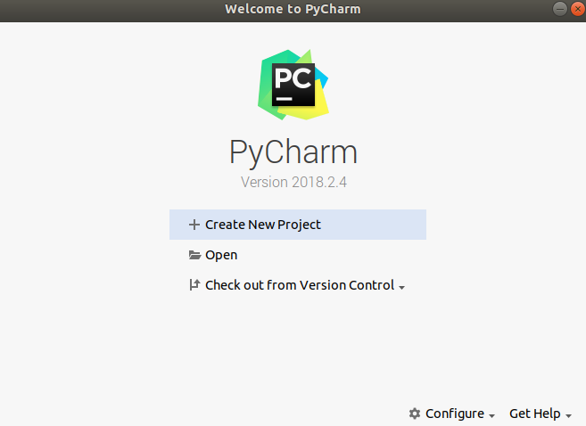
“Welcome to PyCharm” Dialog Box

Slide 17
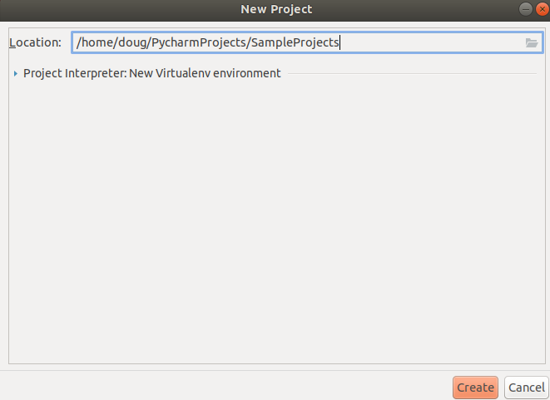
Step three: Enter the project name

Slide 18
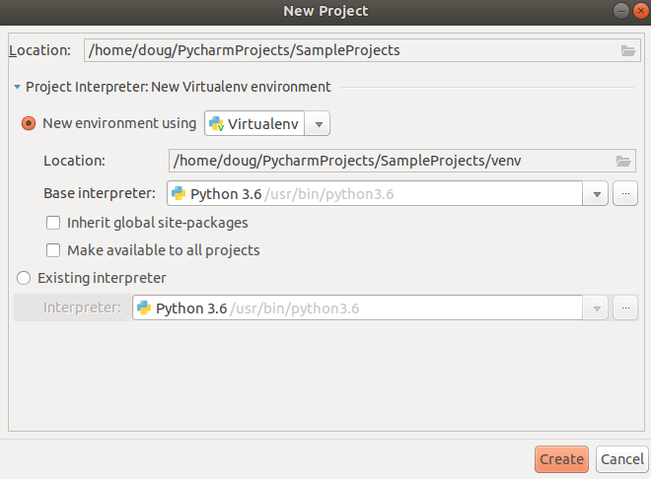
Click Project Interpreter: New Virtualenv environment

Slide 19
3 Types of Virtual Environments
Virtualenv
Pipenv
Conda

Slide 20

But Bro, What’s a Virtual Environment?
Loud mouth red billed gull by Bernard Spragg. NZ

Slide 21
Virtual Environments in 7 Words
A tool for creating isolated python environments.

Slide 22
Why Use Virtual Environments?
They’re considered Pythonic
Imagine you have one app that requires version 2.7 of Requests but another that requires version 3.7. How can you go about developing both apps? If you install everything to /usr/lib/python3.6/site-packages (or where ever you have python installed), then you could end up in a situation in which you upgrade an app which doesn’t need upgrading.

Slide 23
Virtualenv
If you use virtualenv the libraries will get installed in a folder named virtualenv, the isolated environment, instead of installing the package globally which could have unprecedented effects.

Slide 24
Conda
A package, dependency, and environment manager for any language - Python, R, Ruby, Lua, Scala, Java, JavaScript, C/C++, and FORTRAN
Used heavily in data science projects

Slide 25
Pipenv
A tool that according to the pipenv docs brings the best of all packaging worlds (bundler, composer, npm, cargo, yarn, etc).
Pipenv automatically creates and manages a virtual environment for your projects, as well as adds/removes packages from your Pipfile as you install/uninstall packages.
Virtualenv is a lower-level tool while pipenv is newer and higher-level.
We’re going to use pipenv as our virtual environment in this example because it’s endorsed by Python.org

Slide 26
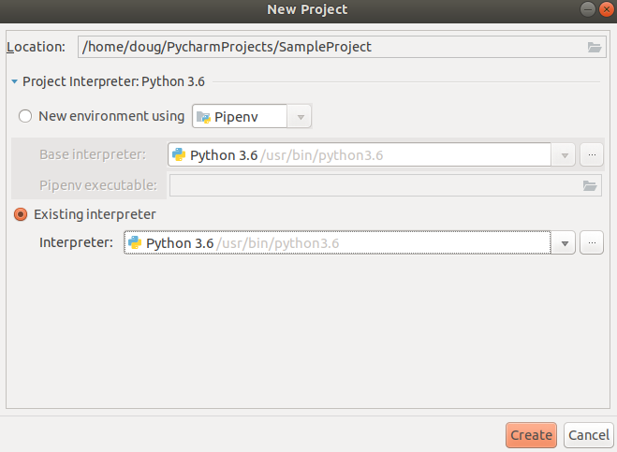
Select Pipenv as Project Environment

Slide 27
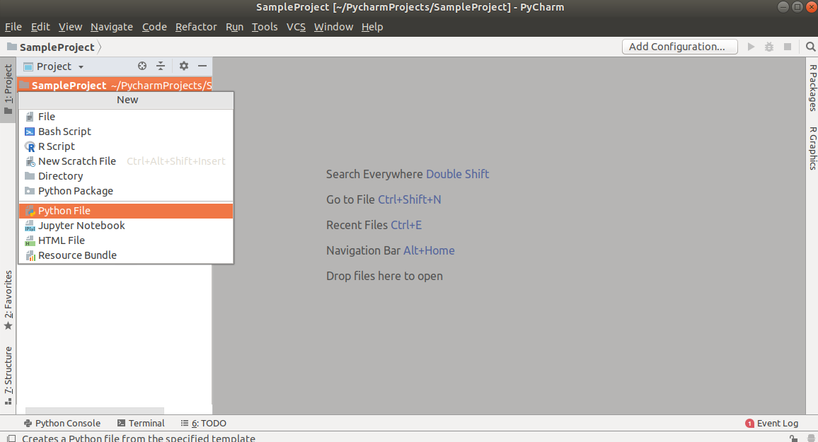
How to run a simple Python Script
Click on File -> New -> Python File
The following file menu should appear:

Slide 28
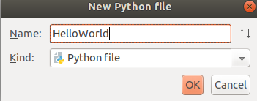
Enter the name of the Script

Slide 29
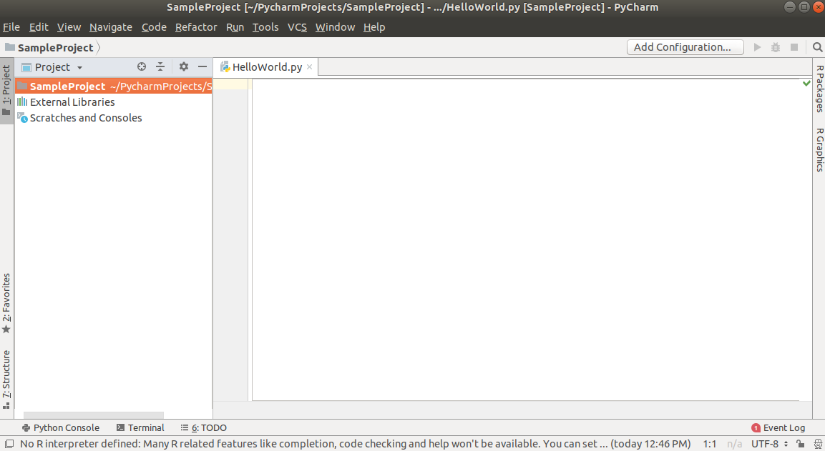
Click OK

Slide 30
Add the following statement to HelloWorld.py
print("Hello World")

Slide 31
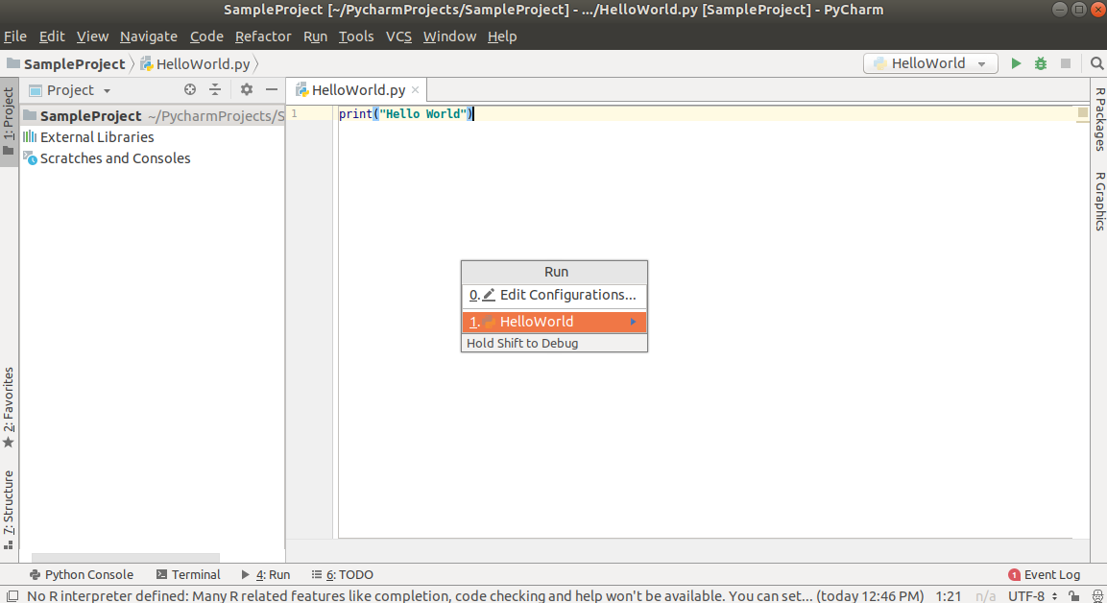
Run -> Run ‘HelloWorld’

Slide 32
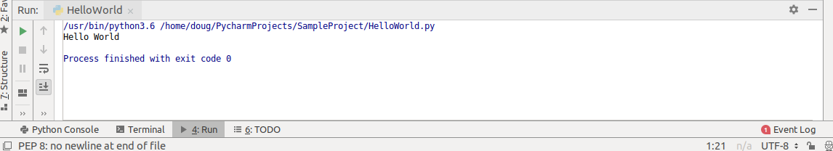
Hello World is Printed

Slide 33
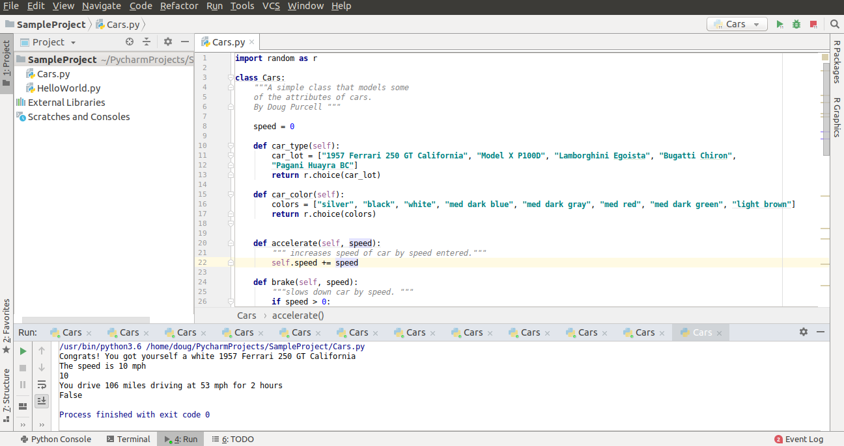
How to Debug a Program in PyCharm
We’re going to run the debugger on this simple script:
Download the program Cars.py on GitHub.

Slide 34
A mini lesson in breakpoints in PyCharm
A breakpoint is an intentional interruption in a program during the debugging process. The point of it is to serve as a checkpoint for further inspection.

Slide 35
PyCharm supports many types of breakpoints.
There’s breakpoints for exceptions, Django, and JavaScript.
A line breakpoint is a breakpoint assigned to a specific line in the source code.
A temporary line breakpoint is assigned to lines of source code and are used to target a particular section for debugging. When this kind of breakpoint is hit they’re removed immediately.
You can read “Types of Breakpoints” to learn about the types of breakpoints in IntelliJ. Let’s set a breakpoint in Cars.py:

Slide 36
How to set a breakpoint in PyCharm
Highlight the statement that you want to set the breakpoint to. In this example the location is line 43 of Cars.py.
Click Run on the toolbar and then select Toggle LineBreak. You could optionally use the keyboard shortcut of Ctr+F8.
Once set the statement should be highlighted with red and on the left hand portion of the statement should be a little-red-circle that indicates that the breakpoint has been set as shown

Slide 37
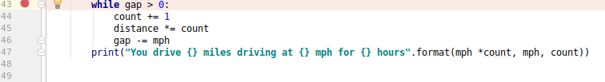
Breakpoint set in PyCharm

Slide 38
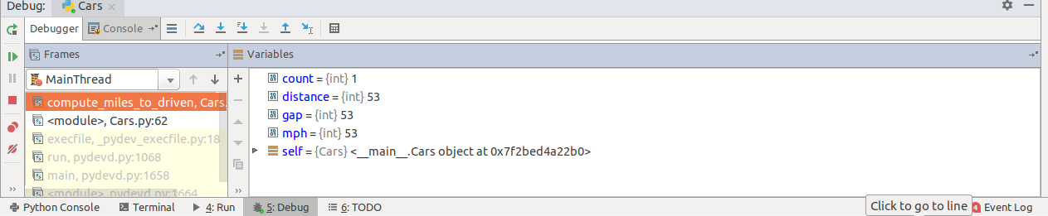
Run -> Debug ‘Cars’ or Shift + F9

Slide 39
Let’s Understand Icons for Python Debugger
(from left-to-right)
Show the current program execution point.
Step Over
Step to the next line executed (F7)
Step to the next line executed ignoring libraries
Step into, ignore stepping filters for libraries, constructors, etc.
Step to the first line executed after returning from this method.
Run to the line where the caret is.
Evaluate arbitrary expression.

Slide 40
Hit the step into icon or F7 2X
And observe how the program changes.

Slide 41
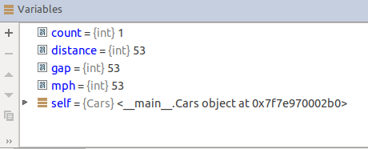
Before

Slide 42
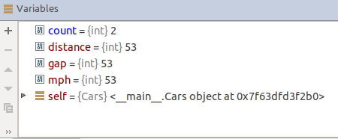
After

Slide 43
What the colors mean?
Blue means that the value has changed while red is the standard color for the variables.

Slide 44
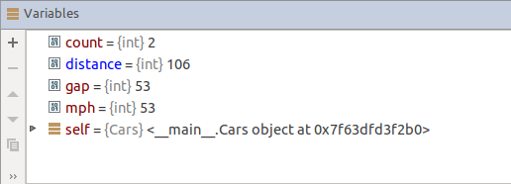
Hit Step Into Button 1X

Slide 45
What Changed? What’s the Same?
All of the variables remain the same except distance which is color-coded to blue.

Slide 46
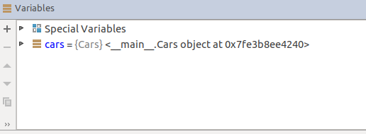
Hit Step Into 3X

Slide 47
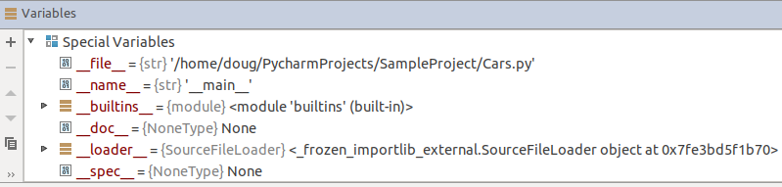
What’s the dealio with these Special Variables?

Slide 48
Double Under or Dunder variable
The Debugger hides dunder names, objects of classes and functions, and util variables in IPython.

Slide 49
Step Out 2X
What happens is a new file opens up which is posixpath.py and it uses the method of dirname()

Slide 50
Step Out 1X
The control jumps inside the abspath() method

Slide 51
Keep Hitting Step out Repeatedly
More methods in posixpath.py are used and you’ll also see that several more modules like saxutils.py and parse.py are used. All of these modules are built into the core of Python.

Slide 52

How to setup your Data Science Environment in PyCharm
Terminator

Slide 53

Install Anaconda

Slide 54
The Inside Scoop of Anaconda
According to their website it’s the most popular data science platform with over 6 million users.
It’s the industry’s standard for developing, testing, and training on a single machine.
There’s also something called miniconda which just ships the repository management system. It’s suggested to install Anaconda if you’re new to conda or Python.

Slide 55
Anaconda Install Instructions
Windows: http://bit.ly/2PrYky0
OS X: http://bit.ly/2Nu834R
Linux: http://bit.ly/2pH9aVp

Slide 56
Configure Conda for PyCharm
File -> New Project, and then enter a project name like Data Science.
Click the arrow next to Project Interpreter: New Virtualenv environment. Click the New environment using drop-down list option and select Conda.
If all goes well the location of the project on Linux machines will be at: /home/user_name/anaconda3/envs/DataScience.
PyCharm should be able to find the location of where your anaconda executable is by default

Slide 57

What if PyCharm Doesn’t Automatically Find the Path?
Cornerstone

Slide 58
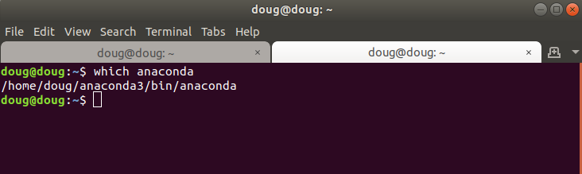
Use the which Command

Slide 59
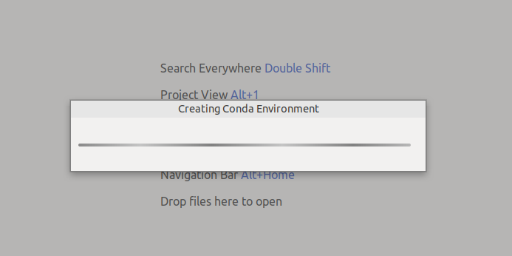
Create the Conda Environment

Slide 60
Enter the Following Code in PyCharm
import matplotlib.pyplot as plt

Slide 61
Dang, it’s not working
We’re trying to import matplotlib, but there’s a red underline which means that PyCharm doesn’t recognize the package. What should we do now? Let’s view our packages in PyCharm.

Slide 62
Manage Packages
File -> Settings, ProjectName (in this case DataScience) -> Project Interpreter

Slide 63
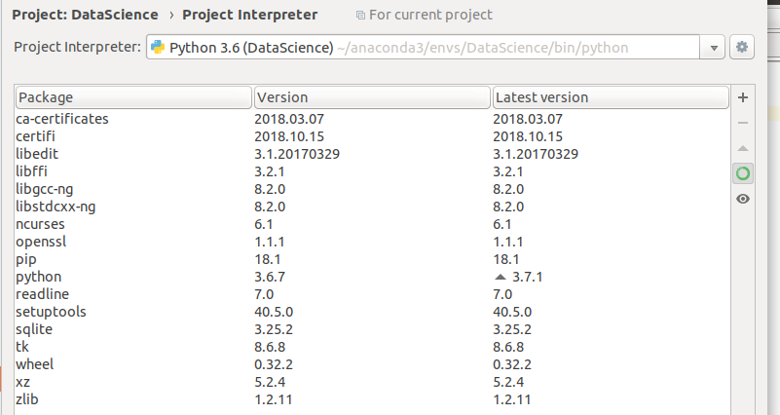
View Packages

Slide 64
Matplotlib is missing!
We need to install it.
Install matplotlib by clicking the plus icon on the right hand side of the Settings dialog box. An Available Packages dialog box should popup.

Slide 65
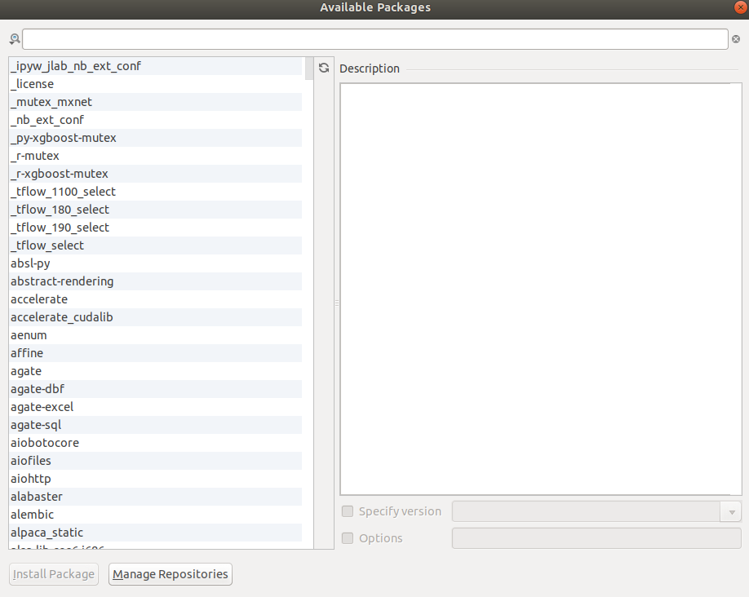
Available Packages

Slide 66
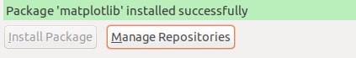
Search for matplotlib
The package name should appear. Then, click the package and click the Install Package button.
Once matplotlib has been successfully installed you should see a success message

Slide 67
Time to test matplotlib
import matplotlib.pyplot as plt
x = [1, 2, 3, 4, 5]
y = [5, 10, 24.82, 72.39, 102]
plt.plot(x, y)
plt.show()

Slide 68
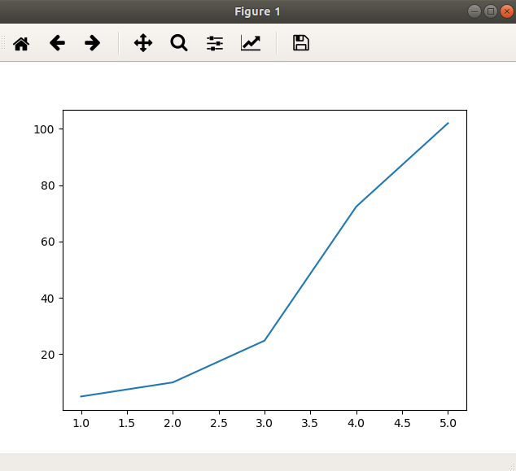
Run -> Run Tests

Slide 69
Create a Histogram
N = 100000
bins = 20
x = np.random.randn(N)
y = .25 * x + np.random.randn(100000) + 10
fig, axs = plt.subplots(1, 2, tight_layout=True)
axs[0].hist(x, bins= bins)
axs[1].hist(y, bins= bins)
plt.show()

Slide 70
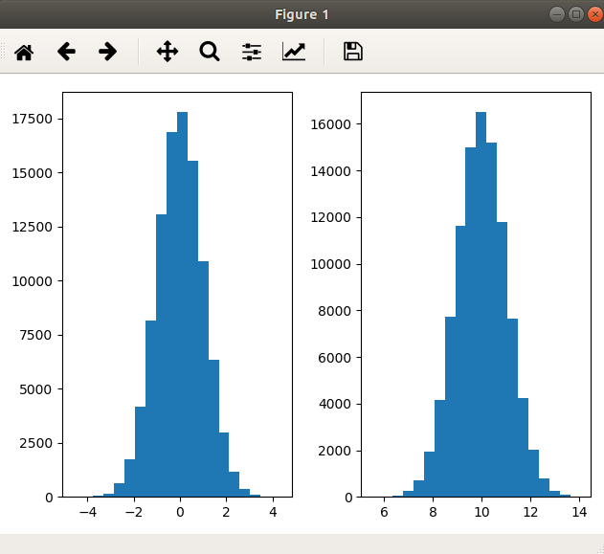
Histogram Plot

Slide 71
SciPy
SciPy is a popular Python library used for scientific computing.

Slide 72
Scipy Installation
Create a new Python file in the DataScience folder. You can name it something like Sci
Install the SciPy package: Files -> Settings -> Project Interpreter -> DataScience (or your folder name). From there click the + symbol on the right corner of the Settings dialog box .
Type in the keyword scipy and then click the Install Package button. Once done wait until the package has finished installing.
Once everything has been successfully installed you should see the message scipy installed successfully. You can test that everything works by copying/pasting the following:

Slide 73
Quick SciPy Test
from scipy.constants import pi
print(pi)
3.141592653589793

Slide 74
Sci-kit Learn
A free machine learning package that’s built on top of SciPy and contains support for classification, regression, and clustering algorithms and interoperates with Python’s numerical and scientific libraries NumPy and SciPy.
You would Install scikit-learn exactly how you installed SciPy with the exception of changing the search query.

Slide 75
Test Sci-kit Learn
# Import scikit learn
from sklearn import datasets
# Load data
data = datasets.load_iris()
# Print shape of data
print(data.data.shape)
(150, 4)

Slide 76
Pandas
A popular open source library primarily used for data analysis.

Slide 77
Installing Pandas and Integrating with PyCharm
File -> Project: DataScience (or whatever project name you chose) -> Project Interpreter
Click the + icon and from there type pandas in the search box and then click the Install Package button. Create a new file and name it something like pan

Slide 78
Copy/Paste the following to pan
import pandas as pd
import numpy as np
data = pd.DataFrame(np.random.rand(10, 5), columns=['A', 'B', 'C', 'D', 'E'])
print(data)

Slide 79
Tensorflow
An open source symbolic math library used for machine learning originally developed by Google Brain.

Slide 80
Install Tensorflow with PyCharm
Click File-> Settings -> Project: DataScience (or whatever the name of your package) -> Project Interpreter
From there, click on the + icon and then type in tensorflow into the text field. Highlight the package name and then click the Install Package button to start the Tensorflow installation process.
Once done, create a new file called Tensor

Slide 81
Copy/Paste the Following to Tensor
# test tensorflow install
import tensorflow as tf
print(tf.__version__)

Slide 82
Integrating R with PyCharm
While this tutorial concerns data science with mainly Python, it’s difficult to ignore another language which is popular in the data science sphere, R.
While the defacto IDE for R is RStudio, you can still handle R programming with PyCharm. Below are the steps to doing just that.

Slide 83
Let’s install and test R in 4-steps
Step 1: Download the latest version of R appropriate for your operating system.

Slide 84
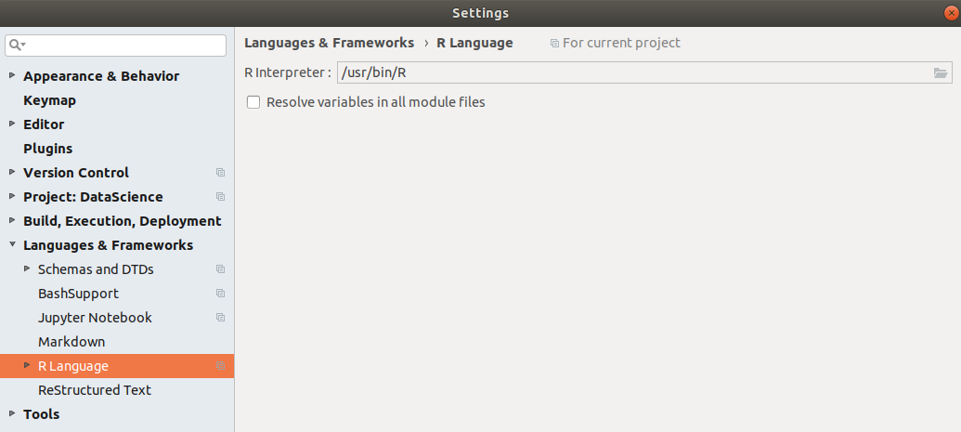
Step 2: Set the Path to R
Click File -> Settings -> Languages & Frameworks -> R Language
You should come to a dual listbox that looks like the following:

Slide 85
Step 3: Create New R File
Click File -> New Project, and type in something like r_code. Once the project is created click File -> New -> R Script, and then enter the name of the script like Test.From there copy/paste the following code snippet:
print(sample(1:5))
print(sample(1:5, size=5, replace=FALSE))

Slide 86
Step 4: Run the File
Run -> Run, and then click the name of the file which is Test. The program should output something like the following:
/usr/bin/R --no-save --quiet
[1] 5 4 1 3 2
[1] 4 1 2 5 3

Slide 87
That’s all Folks
My Name: Doug Purcell
Best way to connect with me:
LinkedIn, I’m very active there: https://www.linkedin.com/in/doug-purcell
Email never fails: purcellconsult[at]gmail[dot]com
My latest project is Become a Python Developer and is available on Amazon in e-book and paperback format.

